Slide 1
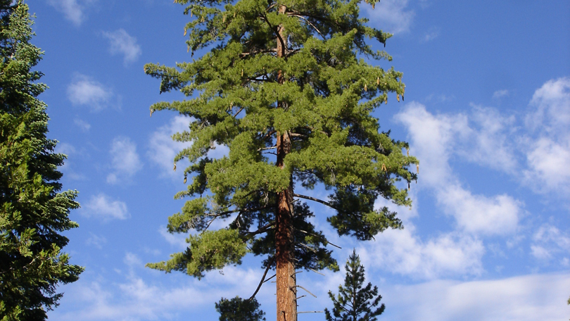
Sugar Pine
Demographic Status, Trajectories, and Stressors
Notes:
- This project is a demographic assessment of sugar pine using nearly range-wide plot data

Slide 2
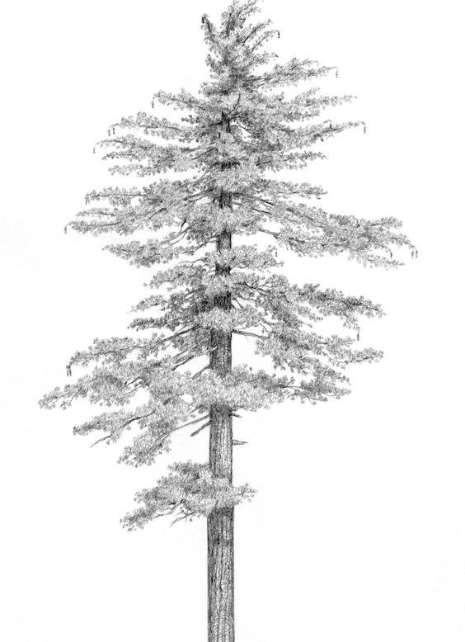
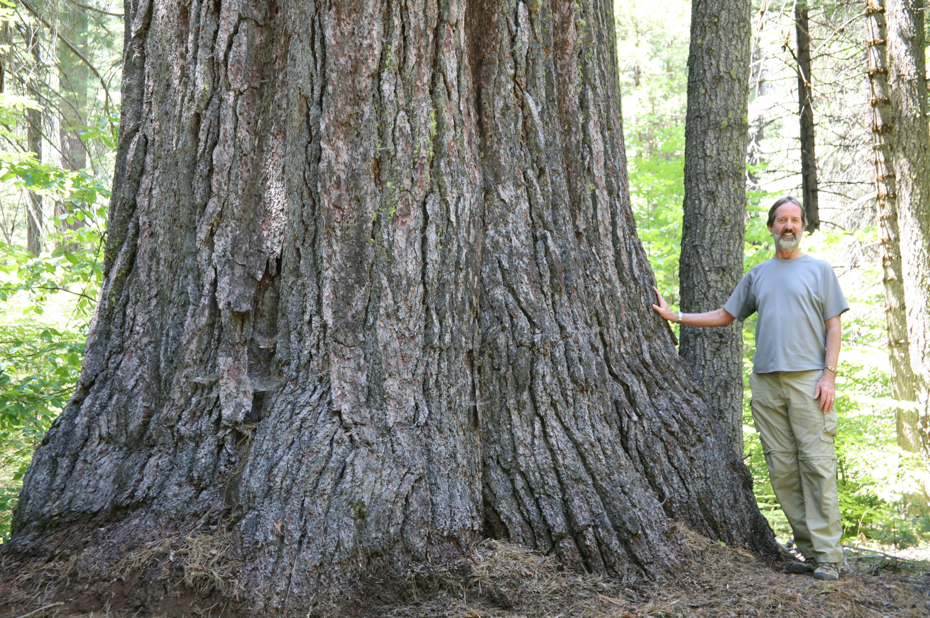
Pinus lambertiana (sugar pine)
Rick Messierorg
Matt Strieby
Notes:
Why sugar pine?
Sugar pine is an important component of the mixed conifer forest type which is common throughout California and Oregon in the western US.
It generally makes up 5-25% of basal area in forests where it occurs
Sugar pines are important commercially for their timber, their seeds are an important food source for wildlife, and large trees like sugar pine provide important ecological services.
Finally, it’s just a cool tree: Sugar pine is the largest of the pines, which has earned it the nickname “queen of the Sierra”
However, sugar pine is facing numerous threats.

Slide 3
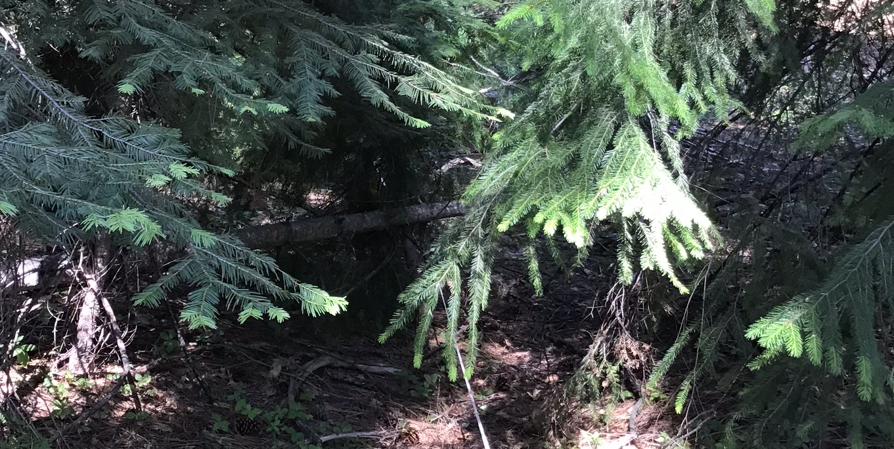
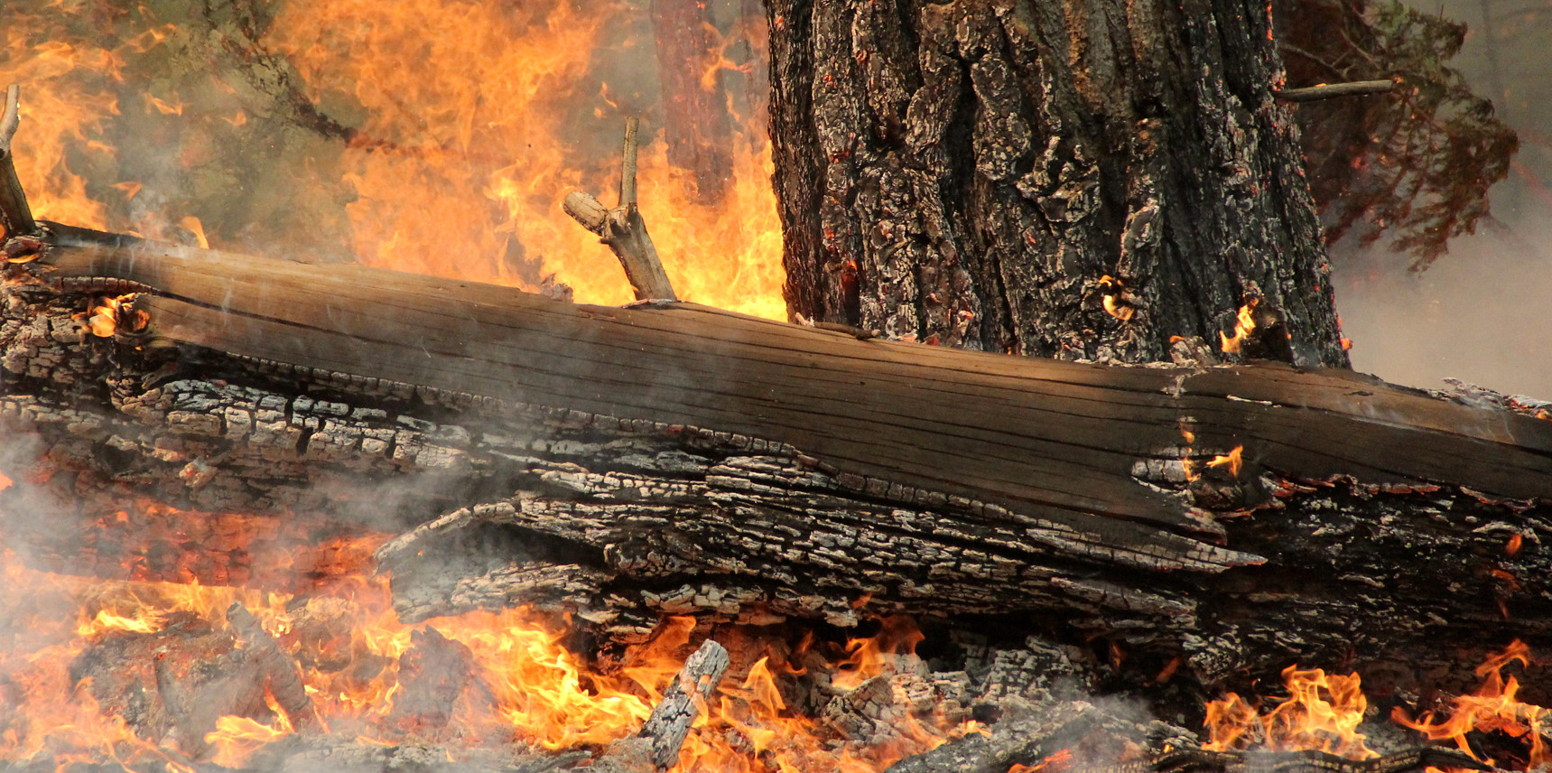
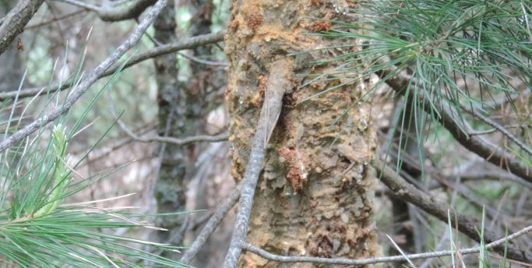
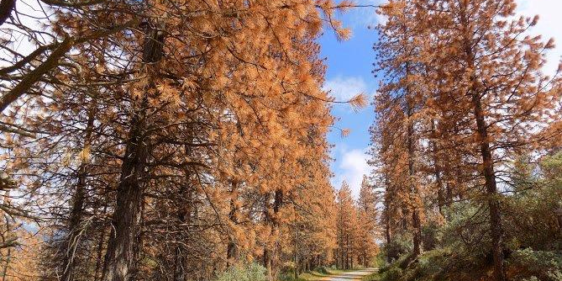
Stressors
Densification
Fire
Hudson Northrup
USFS Region 5
Drought + bark beetles
White pine blister rust
Sugar Pine Foundation
USFS Region 5
Notes:
The mixed conifer forests where sugar pine occurs are adapted to a high frequency / low severity fire regime.
Effective fire suppression and widespread logging in the 20th century disrupted this disturbance regime. Without frequent fires, the second growth forests have grown back much denser than they would have been historically, with negative consequences for sugar pine, which is one of the less tolerant MCF species.
Fire suppression has also resulted in a buildup of surface fuels, which in recent years have combined with a warming climate to increase the area affected by high severity fire. Sugar pine is not serotinous and relies on having large fire-resistant adult trees survive the fire to produce the next generation. With the increases in high severity fire, larger and larger swaths of the landscape have no surviving adult trees, which threatens not just sugar pine but the MCF forest type generally.
WPBR is an invasive fungal pathogen which reduces the vigor of large trees and can kill small ones by girdling them. WPBR has become widespread throughout the range of sugar pine since its introduction in the early 20th century.
During the 2012-2016 severe drought in California, millions of stressed trees were killed by extensive outbreaks of bark beetles, including mountain pine beetle, which attacks sugar pine. MPB is an especially severe threat because once the outbreak gets rolling they tend to kill the largest individuals, which are otherwise more resistant to most threats.
This project came about because manangers in Sequoia and Kings Canyon National Parks saw local declines in their sugar pine population and were concerned. They wanted to better understand the status of the species overall and get a sense for how to prioritize management aimed at mitigating these stressors.

Slide 4
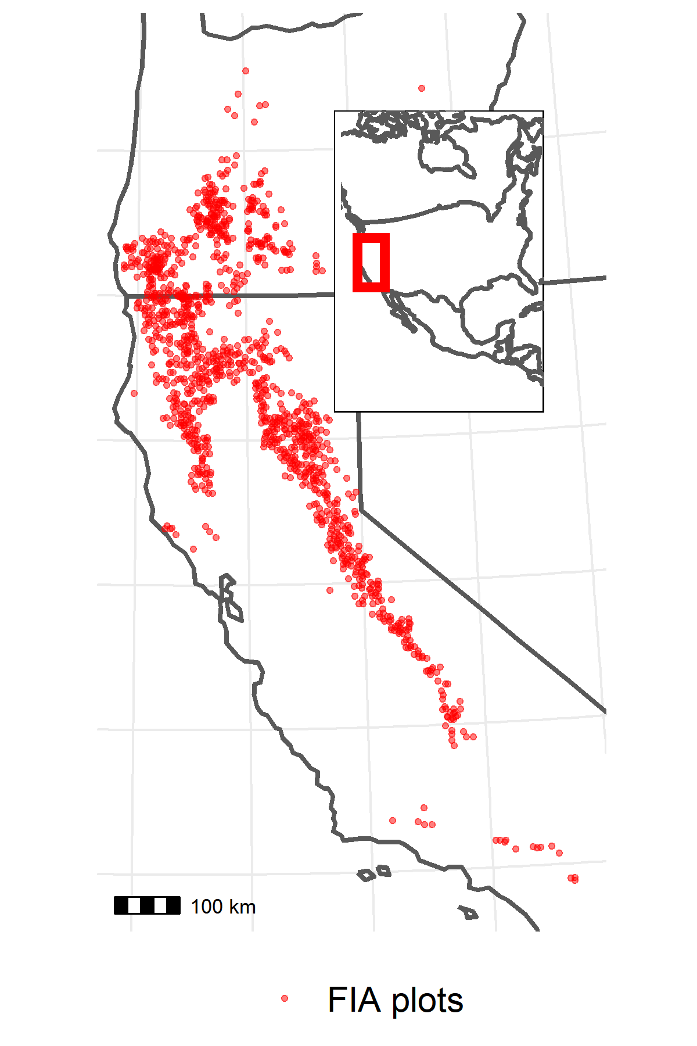
Data
1,221 US Forest Service Forest Inventory and Analysis (FIA) plots
1/10th of plots visited every year since 2001
~10 years between visits, 2 visits per plot
On each plot:
Inventory stems > 2.54 cm DBH
Presence of disturbances (e.g., fire)
Climatic water deficit (CWD) data from TerraClimate
Notes:
Because we wanted to understand the demographic status and role of these stressors across the range of sugar pine, we turned to the forest inventory and analysis (FIA) dataset. This is a nationwide network of field inventory plots which has existed in its current form since 2001.
Plots were established from 2001-2010 and are remeasured once every 10 years, so for this study we have one initial census and one followup census from each of 1221 plots where sugar pine was present.
On each plot, theres a network of fixed area subplots where all stems > 2.54 cm DBH are inventoried (species, dbh, live/dead, disease).
They also record the presence of significant (killed more than 25% of BA) disturbances, such as fire.
We combined this plot data with climatic water deficit data from Terraclimate to understand the climatic conditions experienced by each individual between the initial and followup census.

Slide 5
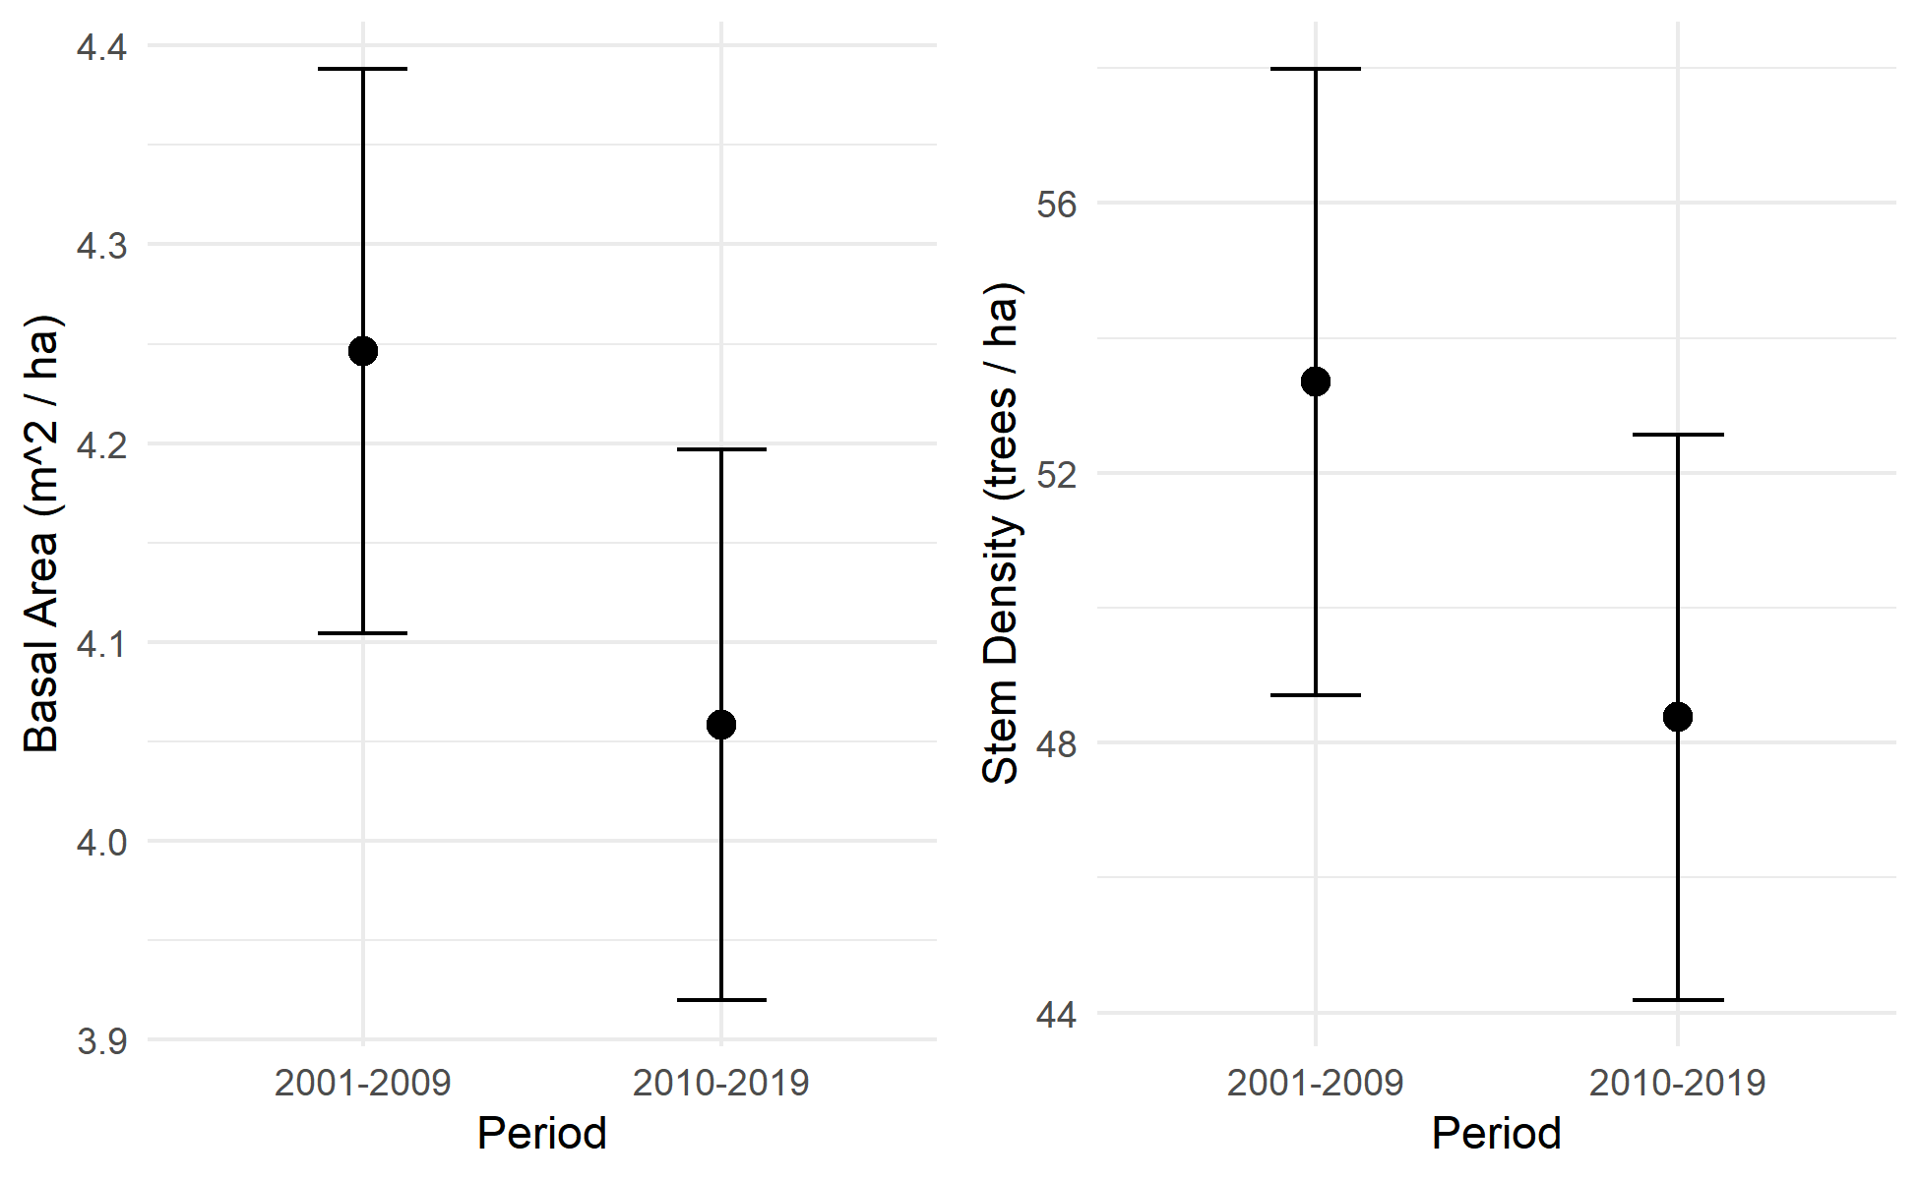
Observed declines in abundance
Notes:
One of the first things we found was that abundance, whether measured by total basal area or total stem density, declined between the initial censuses (2001-2009) and the followup censuses (2010-2019).
This graph shows mean +/- 1 SE basal area and stem density across all plots where PILA was present at initial or followup census.
But we wanted to understand how the various stressors were contributing to this decline.

Slide 6
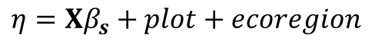
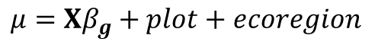
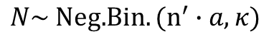
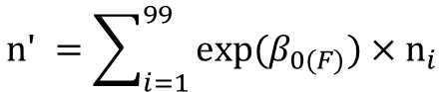
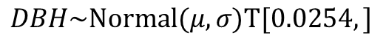
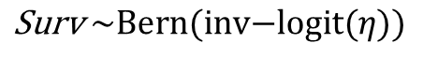
Explanatory variables
Vital rate functions
Survival
Integral projection model
Fire
WPBR
Basal area
Drought
Site dryness
Growth
Fecundity
Size-class transition matrix
Asymptotic population growth rate
Interactions with DBH
DBH
Single-step population projection
$$\text{S}\text{urv} \sim \text{Bern}\text{(}\text{inv}\text{−}\text{logit}(η))$$
$$DBH\sim \text{Normal}\text{(}μ,σ)T[0.0254,]$$
$$\text{n}\text{′ }=\sum_{i=1}^{99}{\text{exp}\text{(}β_{0(F)}\text{)}}×{\text{n}}_{i}$$
$$η=Xβ_{s}+plot+ecoregion$$
$$μ=Xβ_{g}+plot+ecoregion$$
$$N\sim \text{Neg}\text{.}Bin.(n^{′}∙a, κ)$$
Notes:
To do that, we constructed vital rate models for survival, growth, and fecundity and synthesized them into an integral projection population model.
The explanatory variables for the survival and growth functions were ….
Random effects for plot and ecoregion.
Because new recruits were so rare in this dataset, we had to make do with a simpler intercept-only model for fecundity, describing the average number of new recruits produced by each existing stem on the plot.
The response variables were:
survival: Bernoulli-distributed live/dead status at the followup census
Growth: truncated-normal distributed DBH at the followup census
Fecundity: the number of new recruits on each plot at the followup census
Used basyesian estimation to estimate the parameters for these vital rate functions, then used the posterior distributions for the vital rate parameters construct a size class transition matrix for an integral projection model with 99 2.54 cm wide size bins.
We used this integral projection model in two ways:
Projected the change in the average population over a single 10 year census interval under a variety of scenarios (each scenario representing the presence of a single stressors)
Extracted the asympototic population growth rate, to understand the long term outlook for populations under the same suite of scenarios)

Slide 7
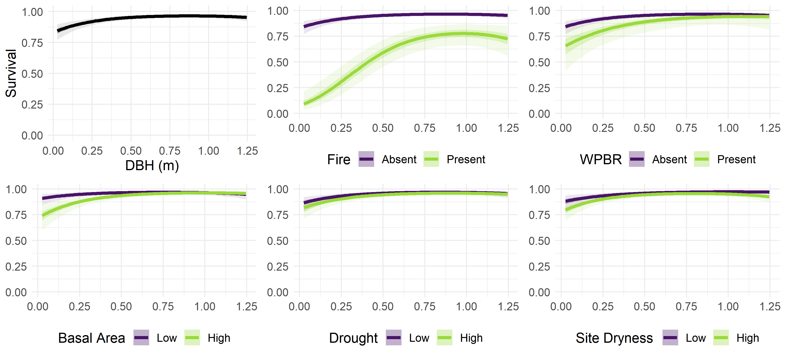
Notes:
Results!
What you’re looking at: Size on the x axis, predicted survival on the y axis. In the top left, fire and WPBR are absent, and other stressors are held at 0 (the scaled mean). In the other panels, a single stressor is present/absent as the green/purple lines, while other stressors are at absent/mean values.
You can see that survival rates were low for the smallest stems, and then increased with size. Theres a quadratic effect for size, and survival actually declines for the largest individuals (graph shows up to the 95th percentile size).

Slide 8
Notes:
What jumps out clearly is that fire had a very strong negative effect on survival rates, for both large and small stems but especially small ones.
WPBR and high neighborhood basal area had less strong negative effects on small stems.

Slide 9
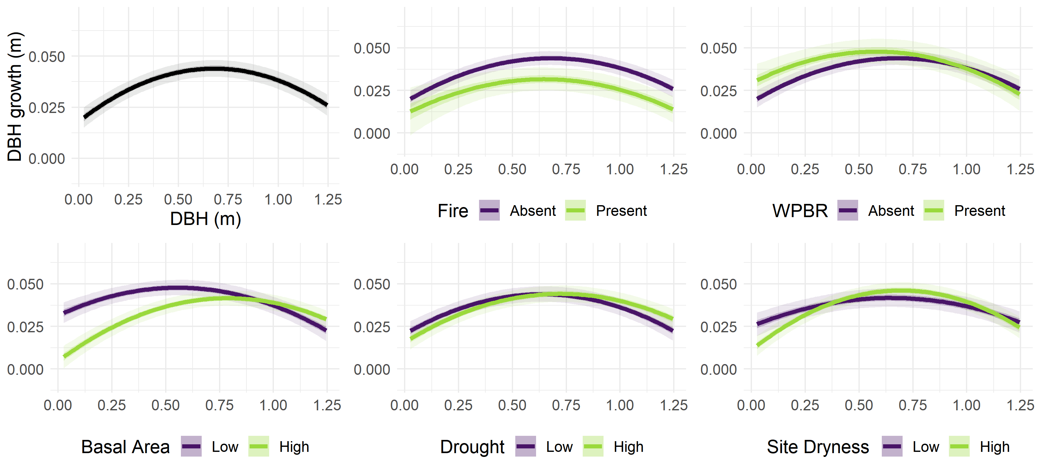
Notes:
Growth: same idea, but now DBH growth (difference between followup size and initial size) is on the y axis.
You can see that smaller stems grew less than large stems, and that growth declined again for the largest stems.

Slide 10
Notes:
Looking at the stressor scenarios,
Again we see a strong negative effect of fire, which reduced the growth rates of all trees regardless of their size.
WPBR actually seems to have increased the growth of the smallest stems but reduced that of the largest ones. I think what’s going on here is that the cankers caused by the disease are actually inflating the stem diameter on small infected trees.
Finally, we can see that high neighborhood basal area dramatically reduced the growth of the smallest stems.

Slide 11
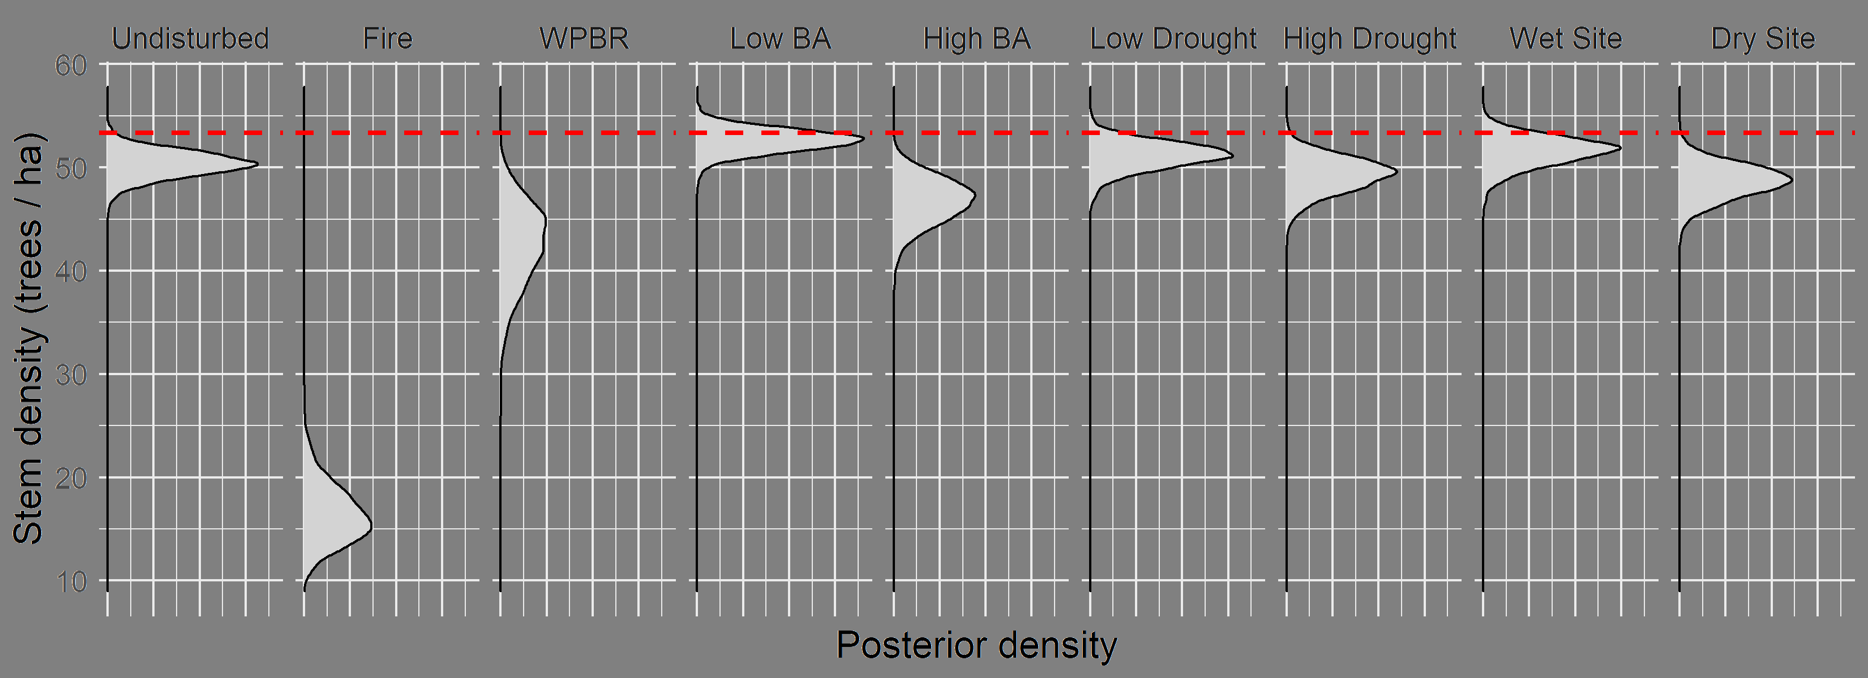
Projected population size (after 10 years)
Notes:
After synthesizeing these susrvival and growth functions with our simple fecundity model, we can project the change in the size of the average population (red line), including the uncertainty in the vital rate parameters.
We see that populations are predicted to decline under most scenarios, including the “undisturbed” scenario where fire and WPBR are absent and BA, dryness, and drought are at mean levels.
The decline is especially severe under the fire scenario, and moderately severe under WPBR and high BA scenarios.
The only scenario where steady state population was plausible was under the low BA scenario, where neighborhood basal area is 1 SD below the mean across all plots.

Slide 12
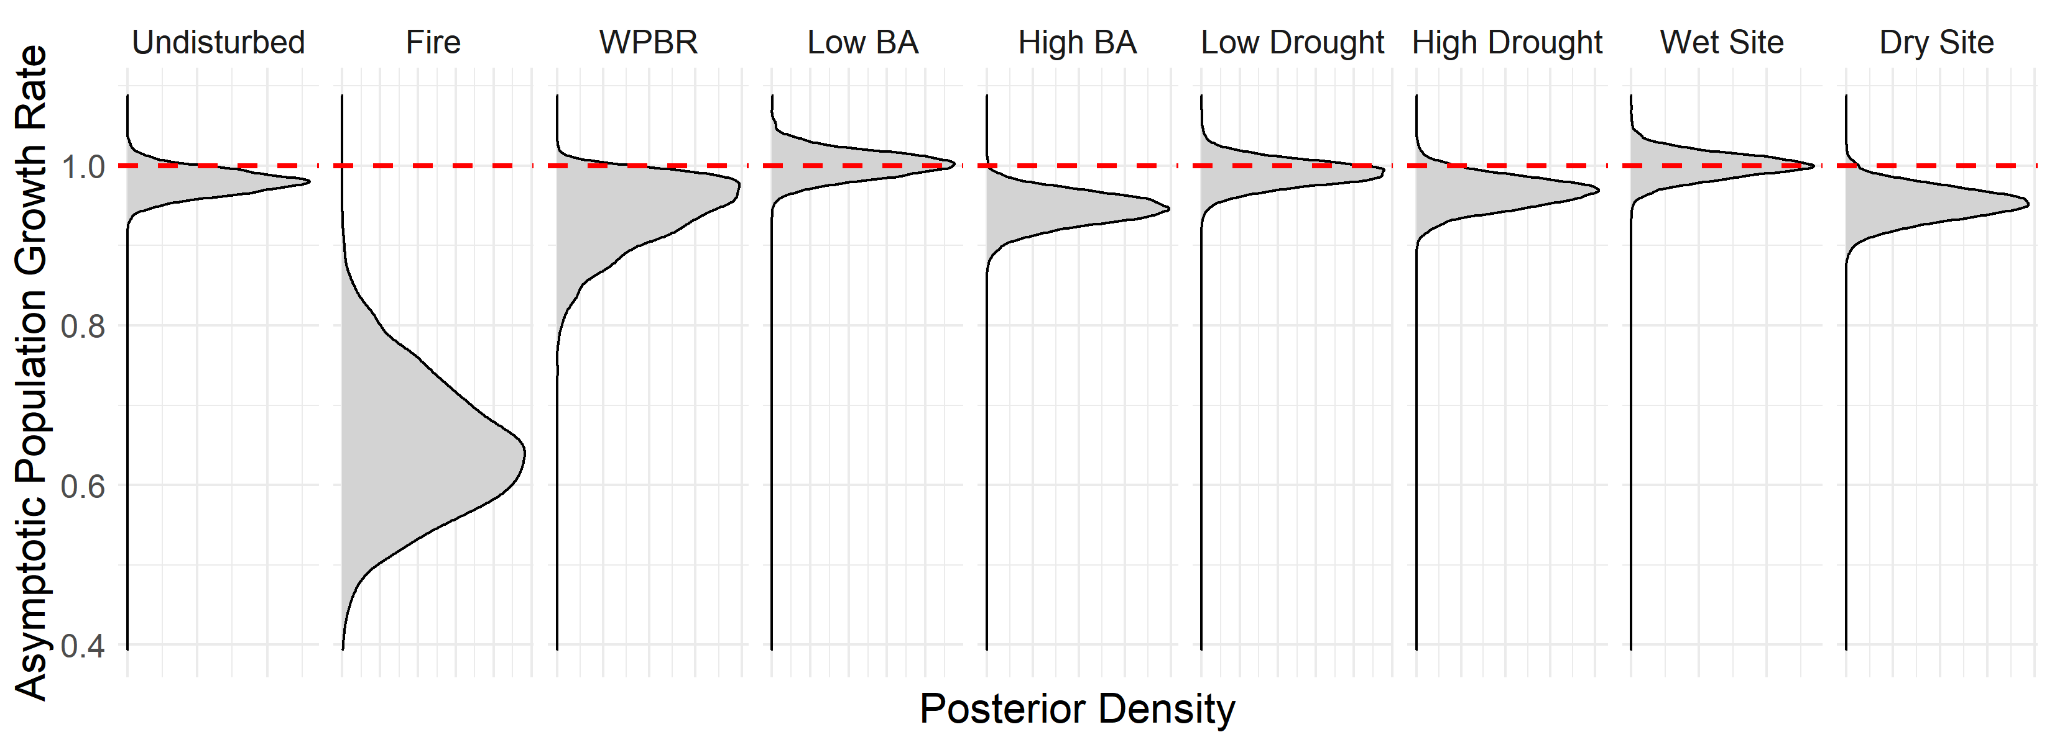
Asymptotic population growth rate
Notes:
And if we project those changes out across many censuses, we get the asymptotic population growth rate.
Where lambda = 1 the population is predicted to be at a steady state, neither increasing nor decreasing. >1 is increase, <1 is decrease
Again we see populations generally predicted to decline long term, including in the undiisturbed scenario.
Fire scenario looks really bad here, but in the real world a fire doesn’t occur every census cycle. What I think is most helpful about this figure is the negative asymptotic population growth rate even in the absence of fire and WPBR, and at mean levels of BA , drought, and dryness. This doesn’t bode well for the outlook of sugar pine.
The bright spots are the low BA, low drought, and wet site scenarios, where population is predicted to hold steady.

Slide 13
Takeaways
Observed population trend is negative
Fire is a severe stressor
Population predicted to decline both immediately and long term under most scenarios
Conservation should address fire risk, density, and WPBR: tractable challenges
More data is needed to understand fecundity
Notes:
Takeaways from this study are:
Observed population trend is negative
Fire is a severe stressor
Population predicted to decline both immediately and long term under most scenarios
Conservation should address fire ristk, density, and WPBR: The silver lining is that these are tractable challenges which forest management can address.
More data is needed to better understand fecundity and its relationship with these stressors.

Slide 14

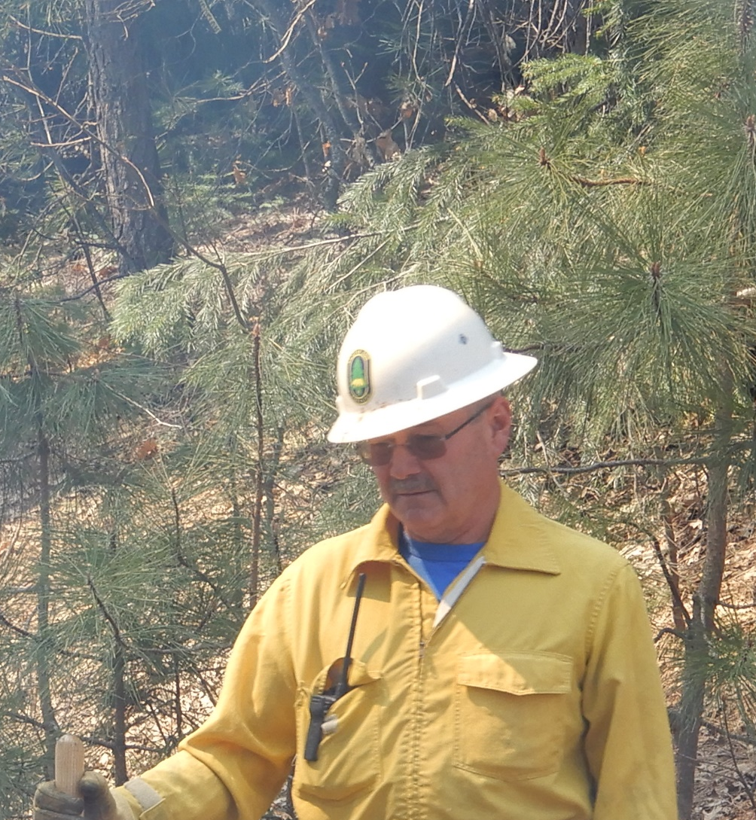


Thanks
Notes:
This work would not have been possible without data from the USDA forest service, funding from the national park service, and the support of my advisors and coauthors Dr. Scott Stephens and Dr. John Battles

